Slide 1



Capstone
Project
Novia: No Violence App Report
Go-to-Market / Sustainability Proposal
Group ID
B21-CAP0213

Slide 2
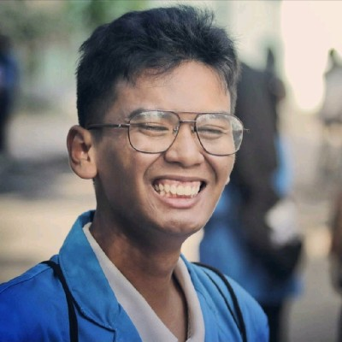
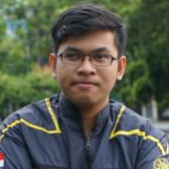
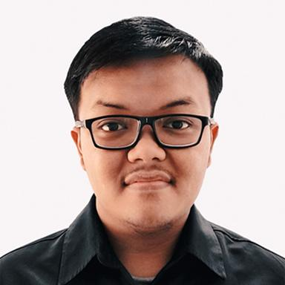


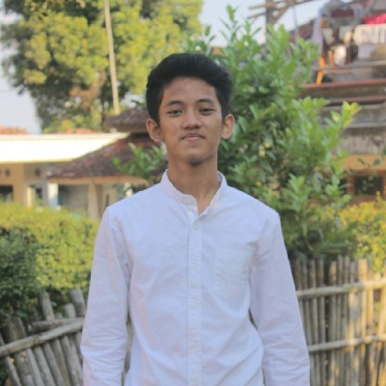
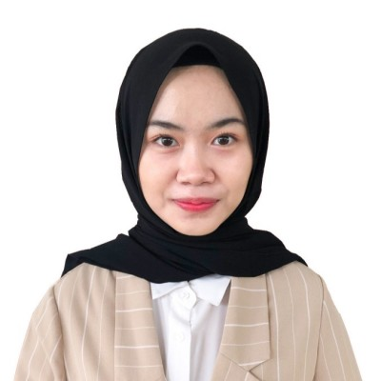
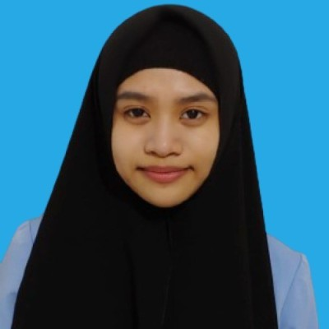

Meet our
members
Tassamu Akhsan N.
M1481712 | Machine Learning
Salomo Hutapea
A0080921 | Mobile Development
Farhan Deristianto P.
A0050493 | Mobile Development
Achmad Rifki R. B.
C2001975 | Cloud Computing
Marissa Leviani
C0050529 | Cloud Computing
Amyra Sarah Luthvia
M0050535 | Machine Learning

Slide 3
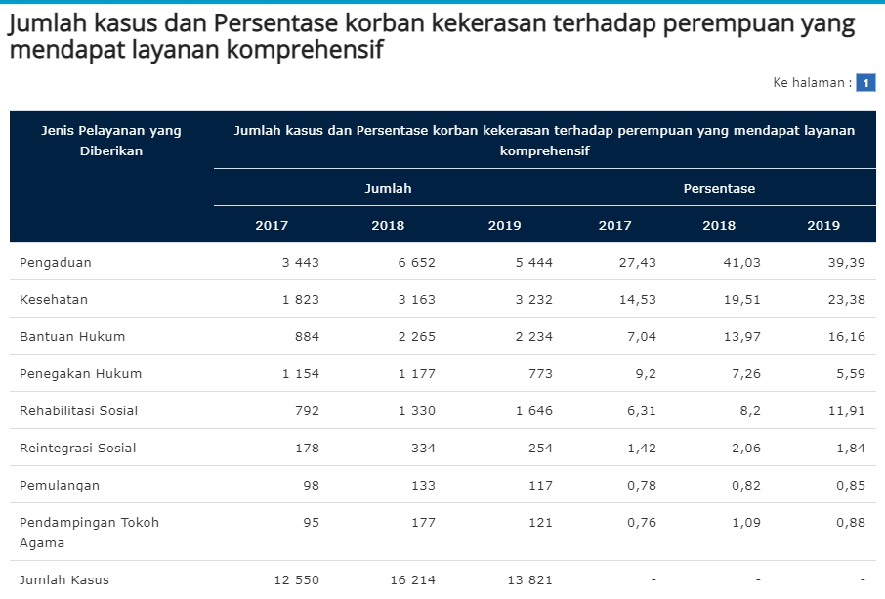
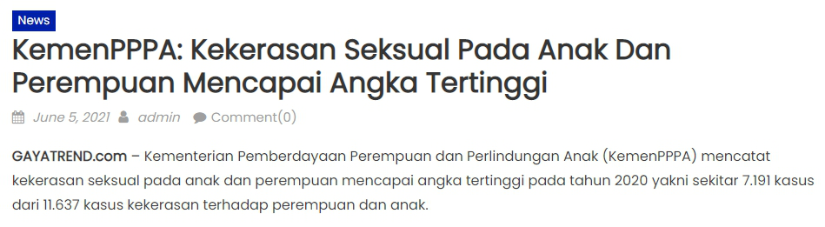
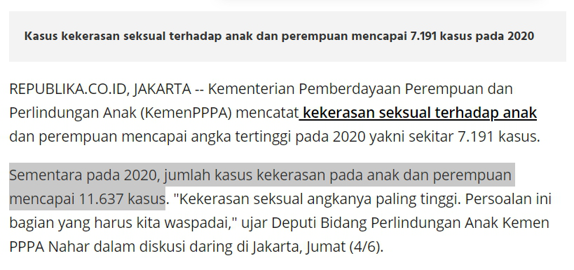
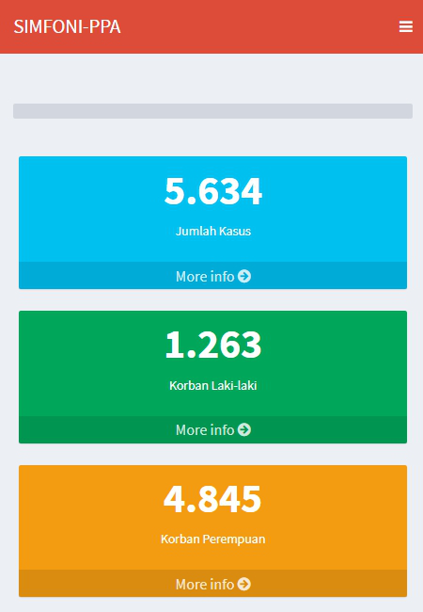
in Indonesia...
11.637
total cases of violence against
women and children in 2020
Percentage of victims of violence who receive right treatment
Source: Badan Pusat Statistik
Source: Gayatrend.com
7.191
cases or 6 out of 10 women and child experience sexual violence
Total cases of violence to women and child;
Last update: June 7 2021, 12.45 PM
Source: SIMFONI-Kementerian PPPA
Source: REPUBLIKA
Source: Ministry of Women’s Empowerment and Child Protection
of the Republic of Indonesia (Kementerian PPPA)

Slide 4
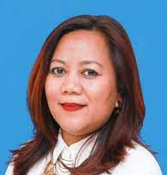
“
The process of reporting from the victims of violence
still took a long time to
filter,
prioritize,
take action.
Ciput Purwianti
from Ministry of Women’s Empowerment and Child Protection of Indonesia
(Kementerian PPPA)

Slide 5
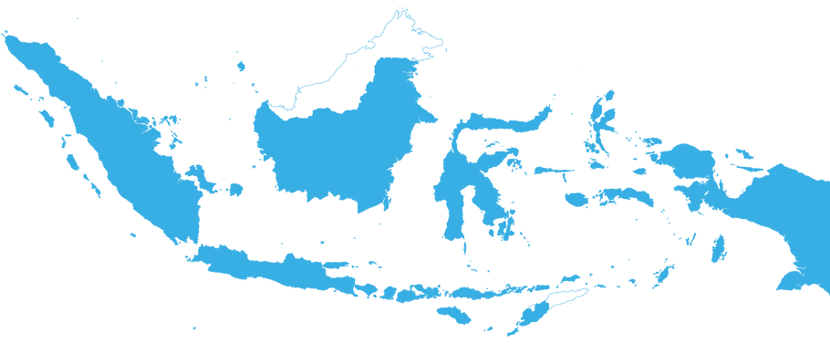



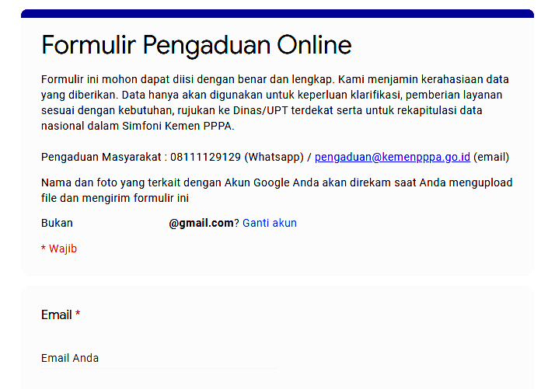
Opening a technical service unit in each province or city
Current
initiative
The data is not synchronized with national data center.
Hotline 1
0821-2575-1234
Create call center / hotline service
to PPPA’s complaint unit
SAPA
129
Hotline 2
0811-1922-911
These phone number is not toll-free yet.
Online Complaint Form
through Google Forms
Looks unconvincing for a government-class institution.
https://bit.ly/kamitetapada
* R E S O U R C E
www.liputan6.com/news/read/4248449/kemen-pppa-sediakan-layanan-pengaduan-bagi-perempuan-dan-anak-yang-alami-kekerasan

Slide 6
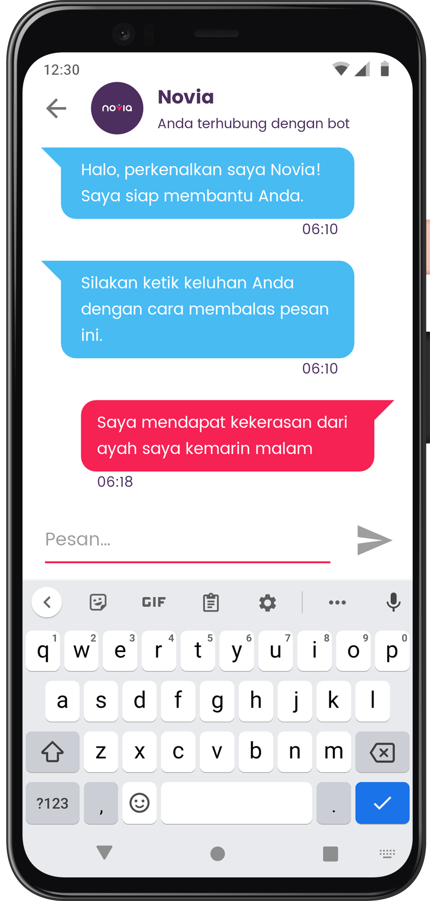
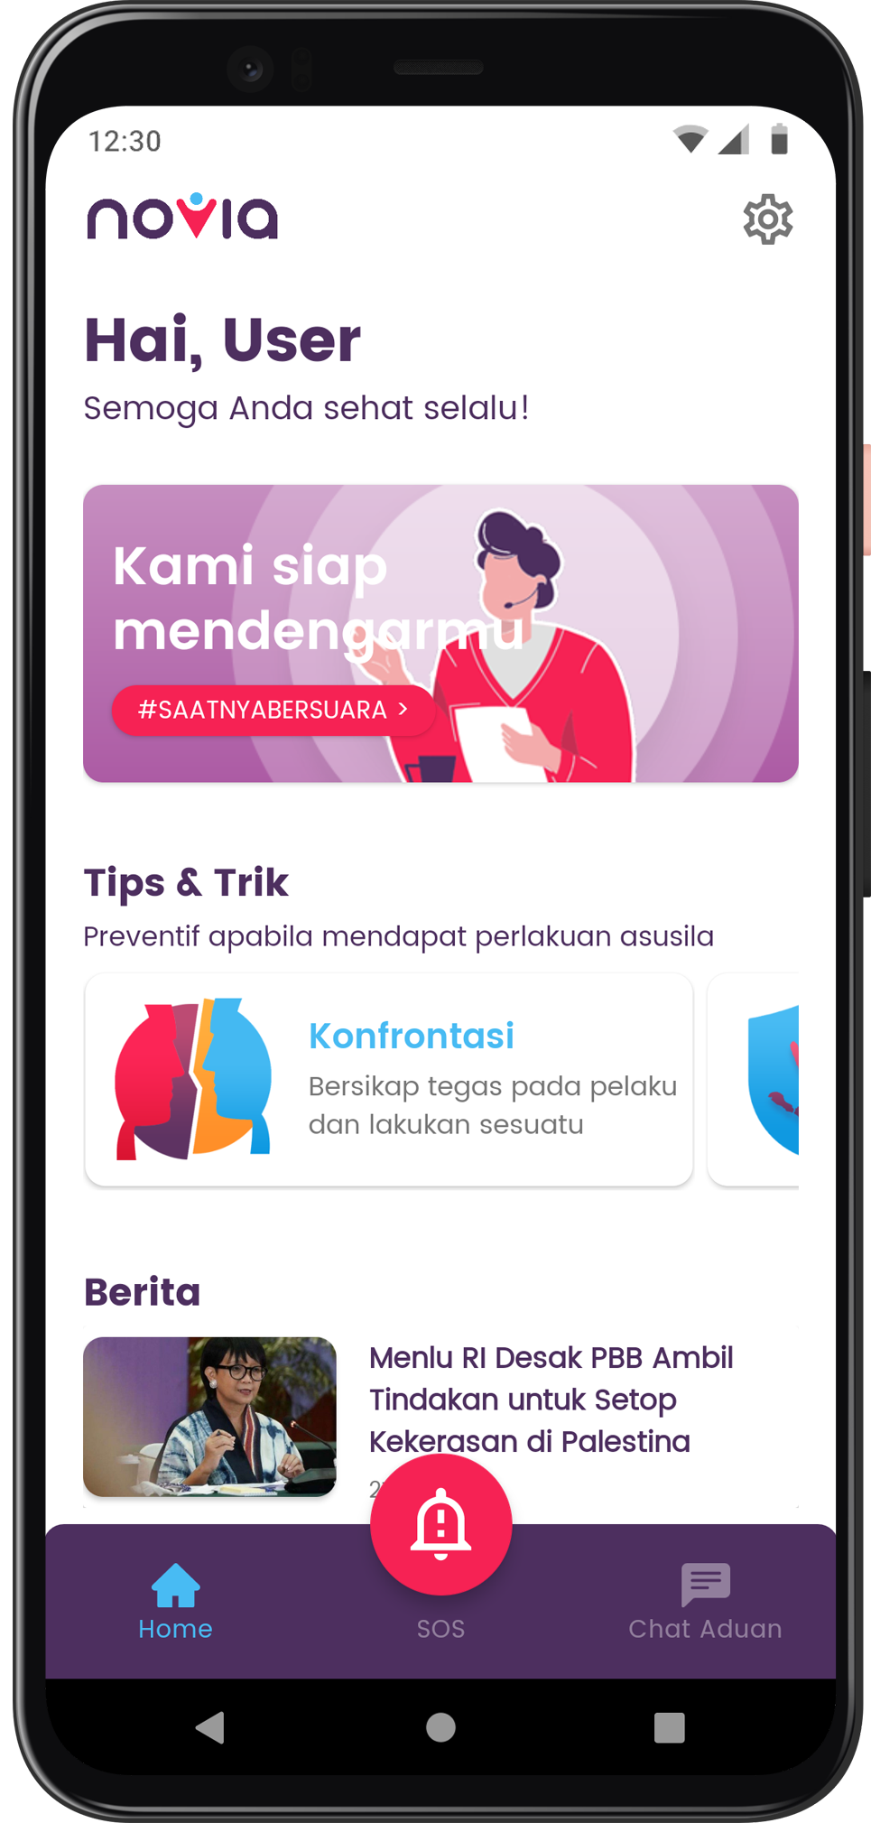

A friendly
reporting app
for any inappropriate acts to woman & child using chatbot.
no-violence app

Slide 7

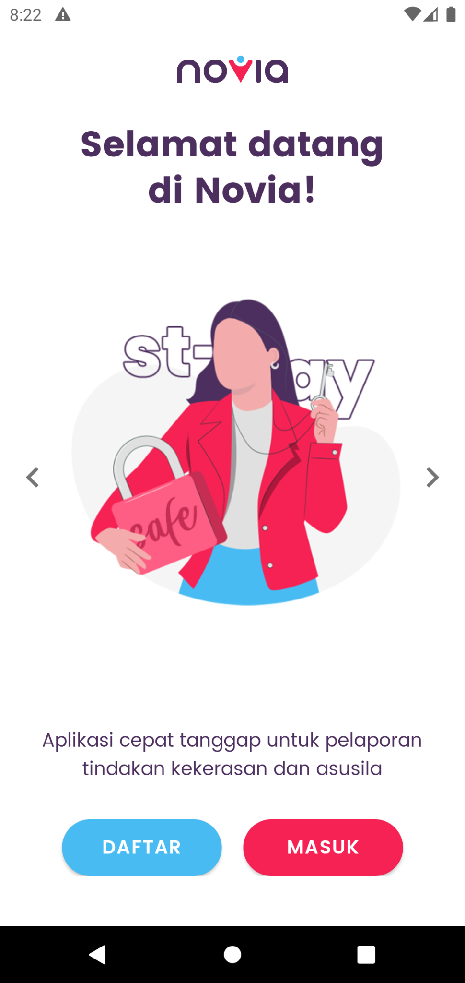

Our goals
faster
way to report
smarter
simplify
system to prioritize
bureaucracy

Slide 8
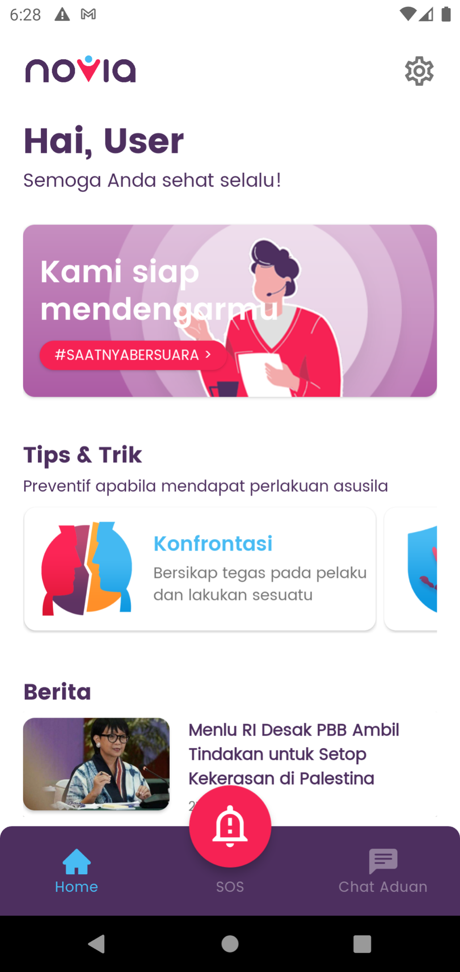
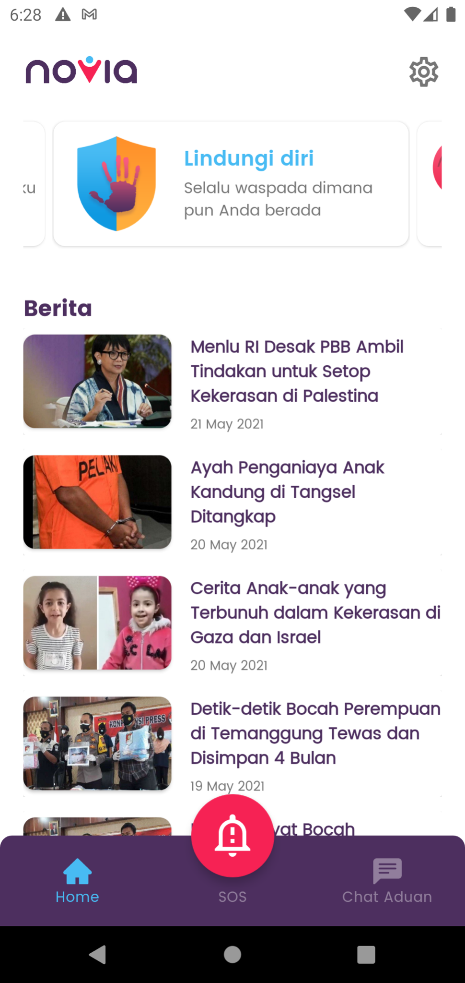
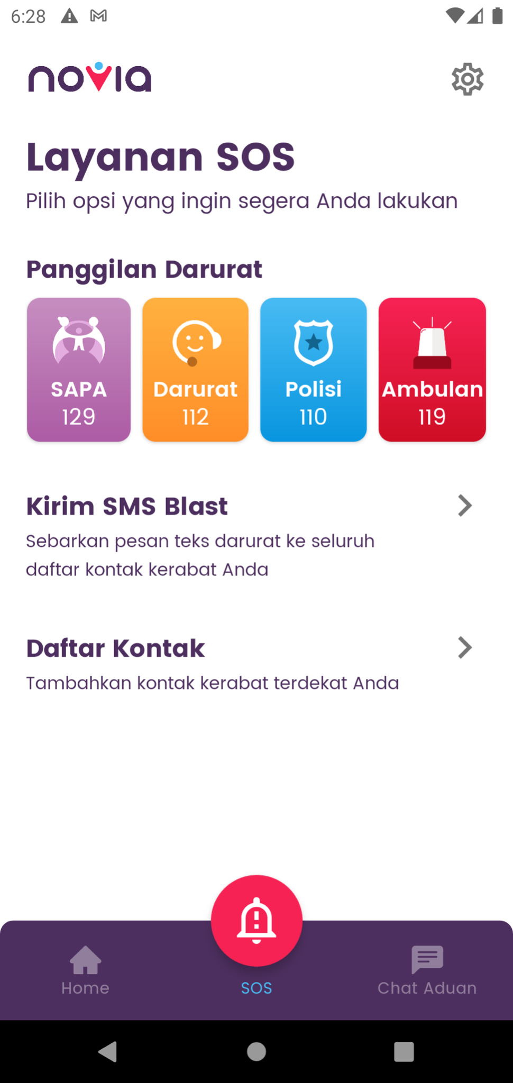
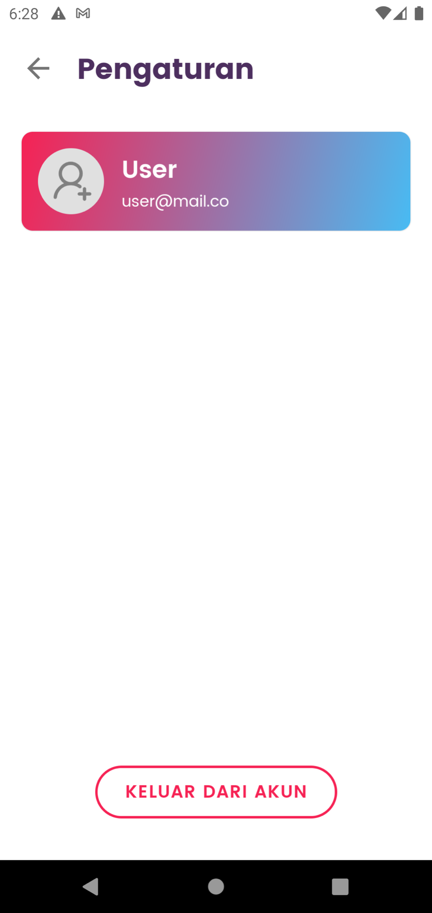
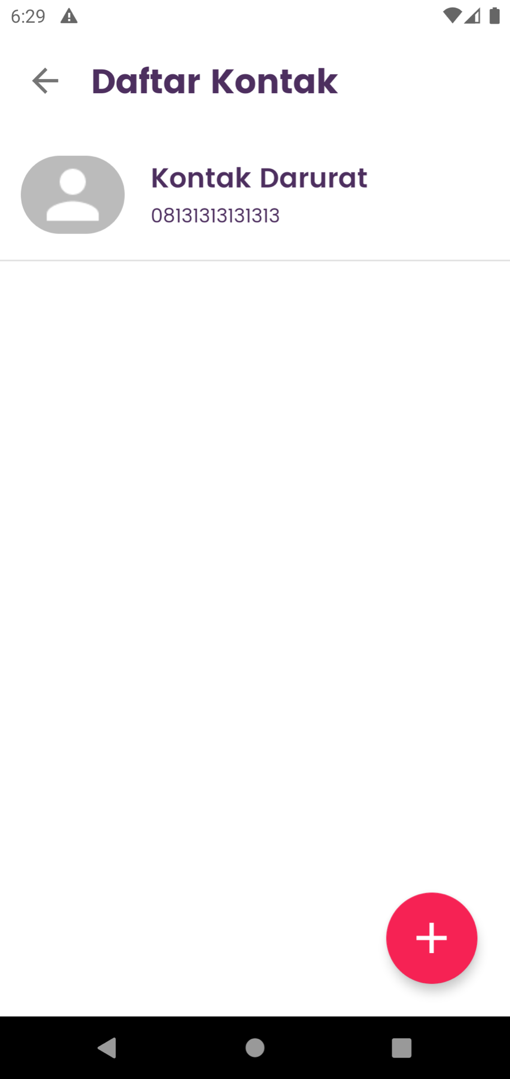
screenshots

Slide 9
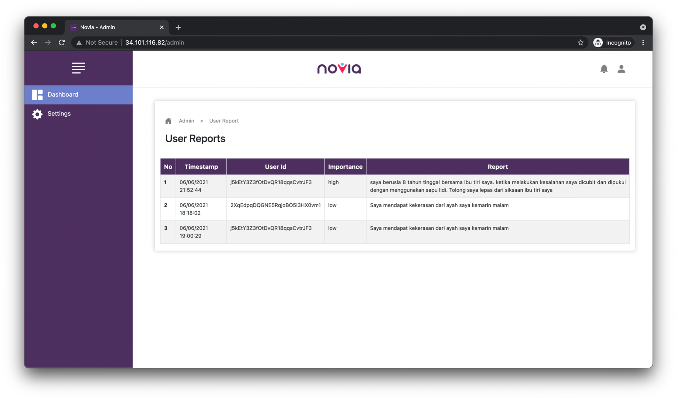
Administrator
website
Display
user reports
database.
Administrator website can be accessed at:
http://34.101.116.82/admin

Slide 10

Target Market or Personas
Age range
13 - 59
Profession
General
Roles
User
Admin
Specific Attributes or likings, hobbies
General

Slide 11
Why your target market needs your solution?
Purpose-driven
Undang-Undang Nomor 23 Tahun 2003 Tentang Perlindungan Anak
Data-driven
There are more than 11.000 cases of violence against women and children in Indonesia. It means that 6 out of 10 women and child experience sexual violence
Government reasoning
RPJMN
Peningkatan Kualitas Anak, Perempuan, dan Pemuda
Stakeholders related and benefitted from your solutions
Kementerian Pemberdayaan Perempuan dan Perlindungan Anak (Kemen-PPPA)

Slide 12
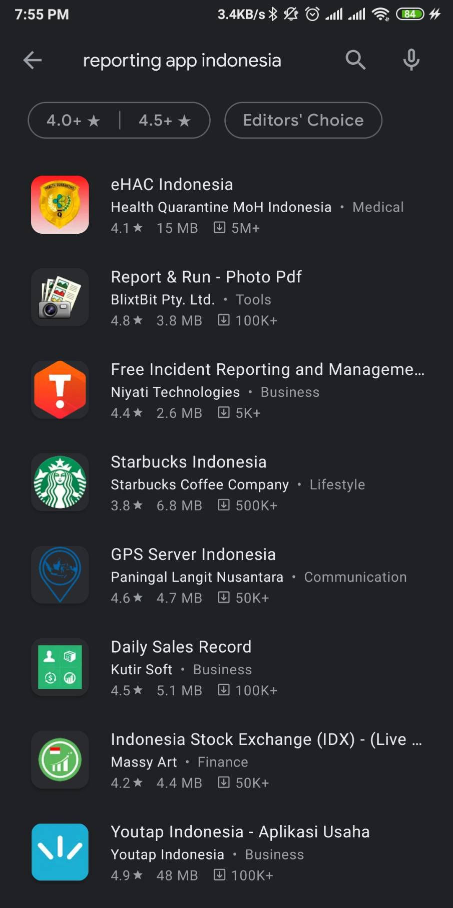
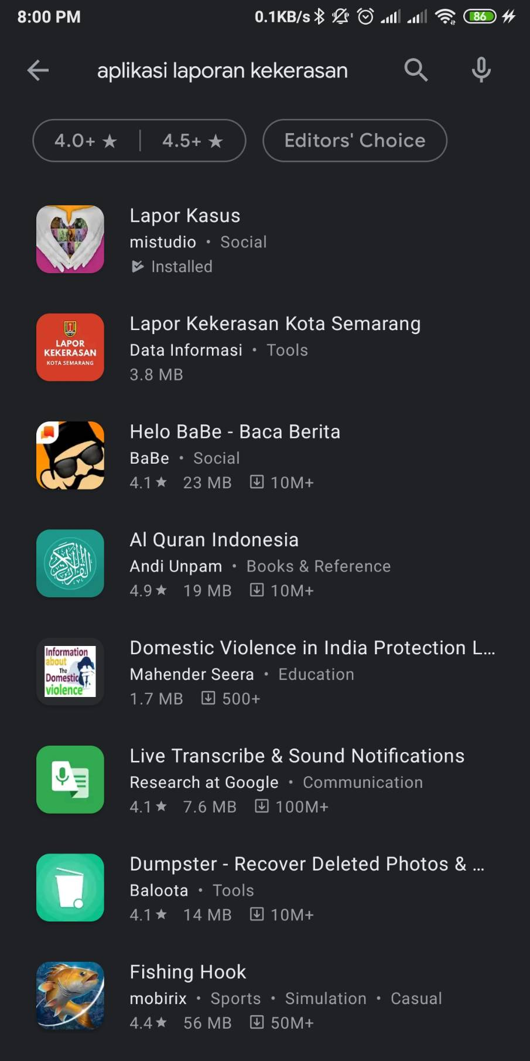
Comparison to similar app
There are only 2 apps that similar to Novia in Google Play Store:
Lapor Kasus (Case Report)
Lapor Kekerasan Kota Semarang (Violence Report Semarang City)

Slide 13
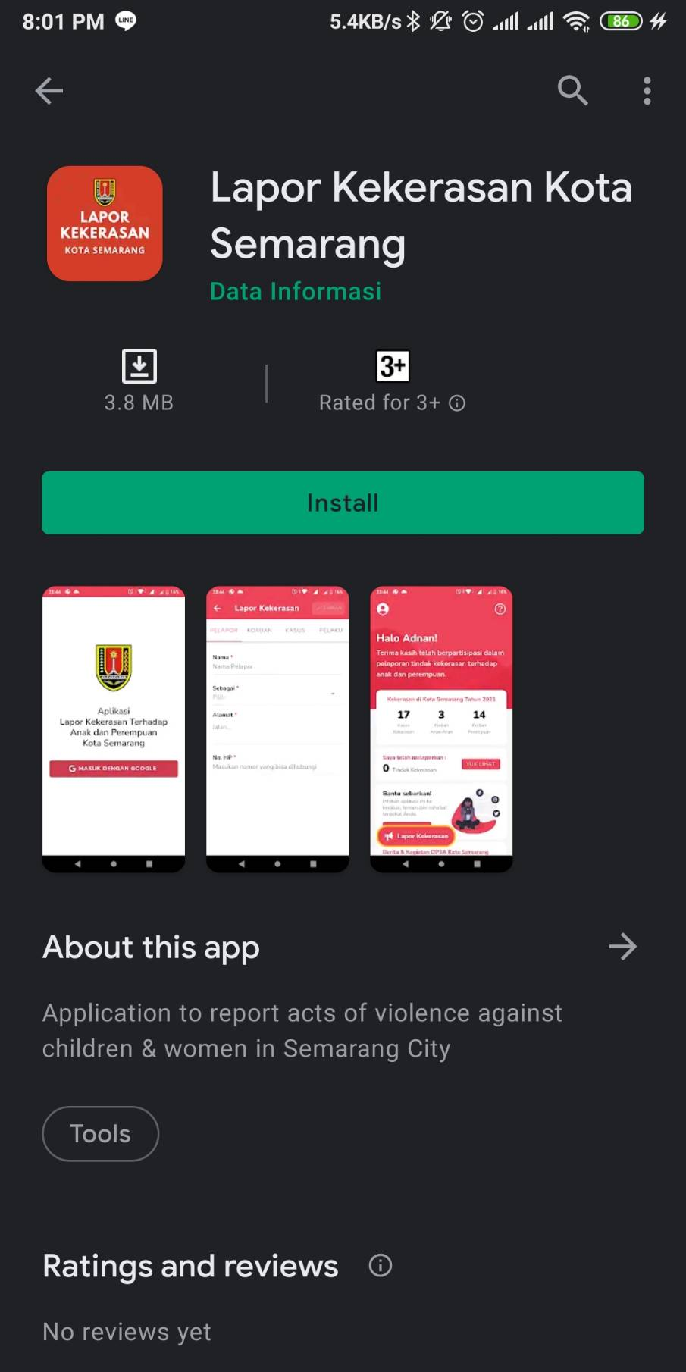
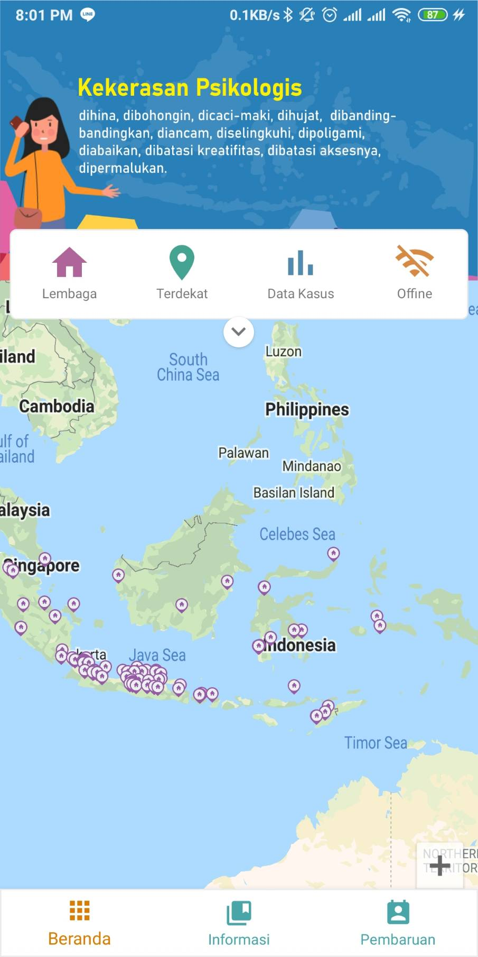
Comparison to similar app
Lapor Kekerasan Kota Semarang
- Only available on
Semarang City
- The app is still
buggy, can not log
in
Lapor Kasus
Although the app name is case report, there is no reporting feature in this application

Slide 14
Roadmap
 | July | August | September
Milestones | - Create form report system with priority detection - Launch on public apps | - 500 downloads - Predict with low, medium, and high priority | - Add Google Analytics to app for better understanding of customer behavior
Marketing & Sales | - Market analysis - Register to Google Play Store | - Promote the app to social media | - Promote the app to social media - Monitor Google Analytics data
Product Development | - Maintenance the app and server - Do more testing, usability testing - Refactoring code | - Maintenance the app and server - Collect more dataset for training | - Maintenance the app and server
Notes:
Aspects of these roadmap categories must be applied

Slide 15
Roadmap
 | October | November | December
Milestones | - 2000 downloads - Chatbot becomes more interactive | - More features, on admin app such as sorting and display user data | - 5000 downloads - New feature, consultation with psychologist
Marketing & Sales | - Promote the app to social media | - Promote the app to social media | - Promote the app to social media
Product Development | - Maintenance the app and server | Maintenance the app and server Deploy new admin app | Maintenance the app and server
Notes:
Aspects of these roadmap categories must be applied

Slide 16
Your Possible Pilot/Trial on the next 6 months (Timeline, Budgeting)
Implementation | Timeline | Budgeting
Launch the app | July | Rp 20.000.000,-
500 Download | July - August | Rp 30.000.000,-
2000 Download | August - October | Rp 35.000.000,-
5000 Download | October - December | Rp 55.000.000,-
Notes:
Aspects of these roadmap categories must be applied

Slide 17
Project Milestones for 2021
(to end of year)
- Create form report system with priority detection - Launch on public apps
- 2000 Downloaded - Chatbot becomes more interactive
July
October
August
December
- 500 Downloaded - Predict with low, medium, and high priority
- 5000 Downloaded -New feature, consultation with psychologist

Slide 18
Budgeting - 1 - USD 5k / IDR 70m
Category | Proportions (max) | Budget (max) in USD
Team Salary | 30% | $1,500 / Rp 21.000.000
Research / Operational Buying/renting things Prototyping Cloud Infrastructure Survey/FGD/data collections Transportation expenses Additional expenses for external experts, observer, respondents Productions preparations, tooling Legalities, patent/copyright registration, product certification | 70% | $3,500 / Rp 49.000.000
Notes:
See details on: https://kedaireka.id/matchingfund https://kedaireka.id/panduan/panduan_matching_fund.pdf

Slide 19
Budgeting - 2 - USD 10k / IDR 140m
Category | Proportions (max) | Budget (max) in USD
All aspects covered in Budgeting - 1 | 50% | $5,000 / Rp 70.000.000
Additional Budget for Team Salary | 10% | $1,000 / Rp 14.000.000
Marketing and Sales | 5% | $500 / Rp 7.000.000
Market research and competitive analysis | 5% | $500 / Rp 7.000.000
Future Development / R&D | 20% | $2,000 / Rp 28.000.000
Other Expenses (taxes, reserves) | 10% | $1,000 / Rp 14.000.000
Notes:
See details on: https://kedaireka.id/matchingfund https://kedaireka.id/panduan/panduan_matching_fund.pdf

Slide 20
Sustainability
Sources of Income
Efficiency Priority
Project (proyek): -
Grants (hibah): -
Soft Loan (pinjaman): -
Rounds of Funding (pembiayaan): Rp 140.000.000
Running with bare-minimum operations
Reducing overhead and unnecessary costs
Reducing travel and miscellaneous expenses
Choose appropriate services and third-party vendors

Slide 21
Based on the 5k/10k USD Budgeting, expectations are
5K Funding
10K Funding
Expected Runway: 6 months / 0.5 years
Expected Headcount: 6 people
Assets:
- patent/copyright applications
- data: date, time, location, report data
Expected Runway: 10 months / 0.83 years
Expected Headcount: 8 people
Market Positioning: 5000 users
Assets:
- knowledge / trained persons: 8
- data: insight of violence act in each category
- Website Dashboard to real-time monitor report
Notes:
Sample, please modify

Slide 22




Capstone
Project
Thank you!
Group ID
B21-CAP0213
Notes:
And that’s a wrap! Thank you for your time and attention. See you in the future!

